Slide 1

Unity WebGL for Dummies (like me!)
by Kevin Murphy - RetroNeo Games

Slide 2
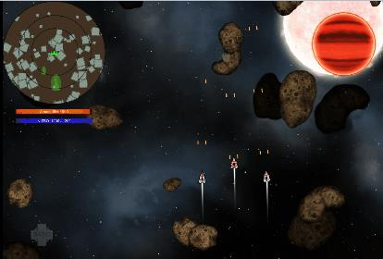
Who’s this dummy?..
RetroNeo Games
Blog weekly
Background
Contact
Twitter: @kmurphygames @retroneogames Email: kevin@retroneogames.com

Slide 3
Unity’s WebGL builds
Solution to the phasing out of browser plugins
Web Player will die. Google stuck in the first knife.
NPAPI
No longer ‘preview’, Web Player Deprecated

Slide 4

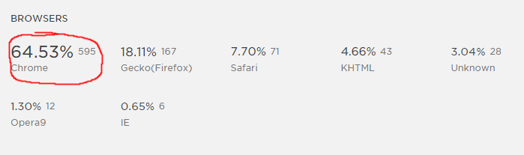

Slide 5
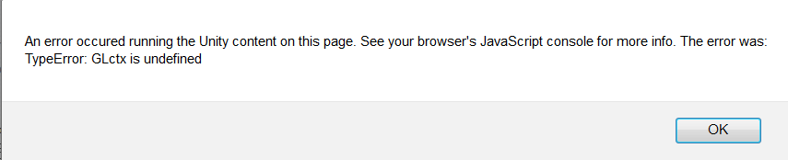
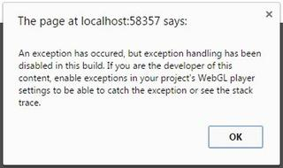
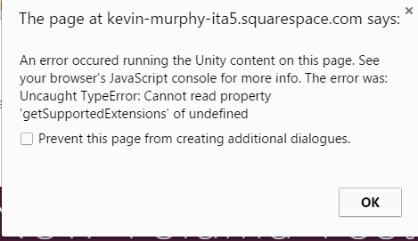
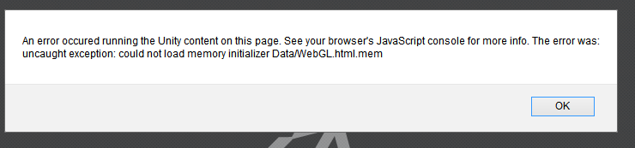
Problems like these

Slide 6
Brute Force Time!
Snozbot & other games
Started building simple new projects
Went through my old projects line by line
Chris Gregan’s 2 suggestions: 3rd party plugins or Project Settings

Slide 7
My First Major Breakthrough
Unity 4 is the problem!
Converting U4 to U5 projects somehow kills WebGL compatibility
Export ALL assets into a clean new U5 project
Must manually reset all tags, layers, collision matrices, inputs, etc
Eureka!

Slide 8
Hosting Online (my solution)
Messing with index.html file? Nope
iframe!
Put build folder in Dropbox/Public
Right-click index.html & ‘Copy public link’
<iframe src="myPublicLink.html" width = 860 height = 700></iframe>

Slide 9
Miscellaneous Info
No IE Support. Who cares?
2GB Max build size
Asset Bundles
No multi-threading
WebGL 2.0 coming
runInBackground?
All browsers working together
Build sizes reducing dramatically
Unity Cloud Build
Gamepad
Audio

Slide 10
Further Reading
RetroNeo Games Blog (or Gamasutra)
Jelly Button Games’ blog (2 parts)
Unity Docs
Unity - Building and Running WebGL
Facebook’s Talk on WebGL
Christopher Pope’s blog

Slide 11
Unity WebGL for Dummies (like me!)
Thank you, DUUG! Questions?

